Slide 1
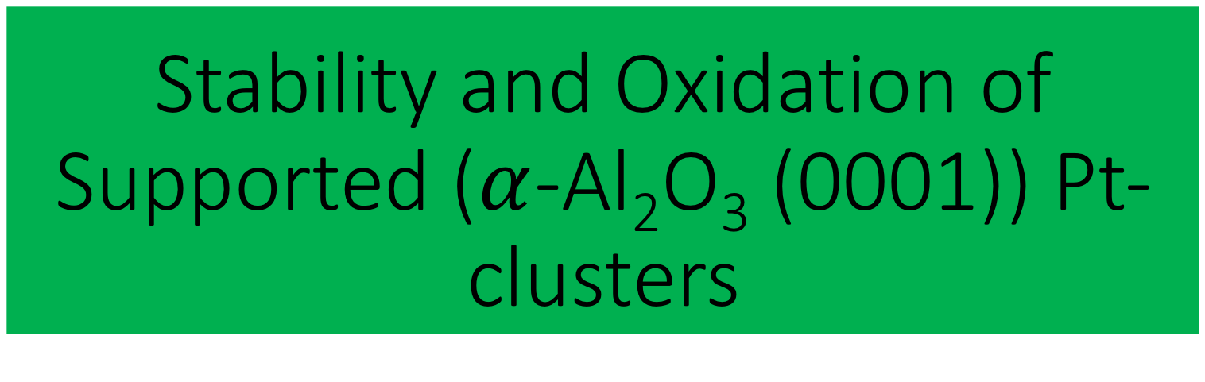
Stability and Oxidation of Supported ($α$-Al₂O₃ (0001)) Pt-clusters

Slide 2
Aim of the Project
Effect of size on structure of Pt clusters:
Pt₇, Pt₈, Pt₁₀, Pt₁₃ (In order to see the structural trends and also to explain the structure-property relationship)
Oxidation of Pt clusters:
Effect of O₂ on structure of Pt clusters with increasing number of O₂
Effect of water on Pt clusters:
It can change the adsorption properties of molecules on surfaces of heterogeneous catalysis reactions

Slide 3
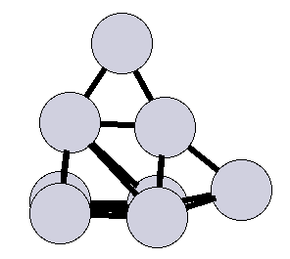
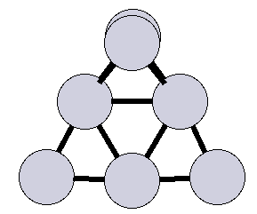
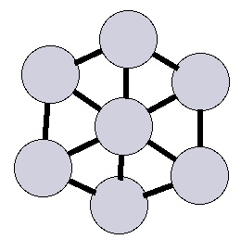
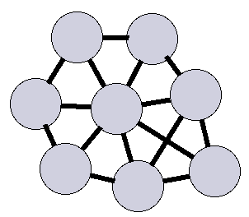
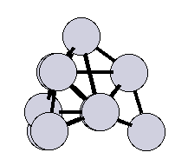
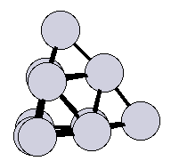
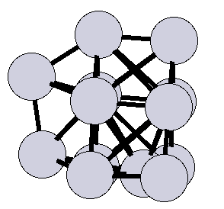
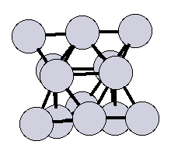
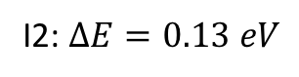
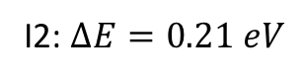
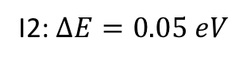
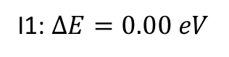
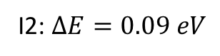
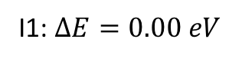
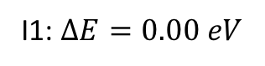
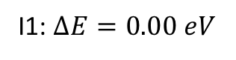
Gas phase Pt clusters
Pt₇ cluster
Pt₈ cluster
I1: $∆E=0.00 eV$
I2: $∆E=0.21 eV$
I1: $∆E=0.00 eV$
I2: $∆E=0.05 eV$
Pt₁₀ cluster
Pt₁₃ cluster
I1: $∆E=0.00 eV$
I2: $∆E=0.13 eV$
I1: $∆E=0.00 eV$
I2: $∆E=0.09 eV$

Slide 4
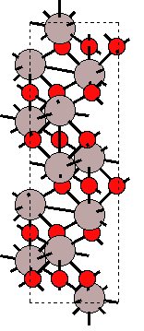
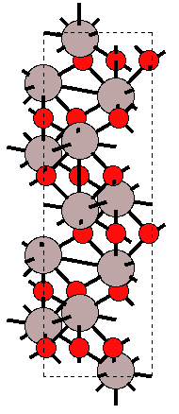
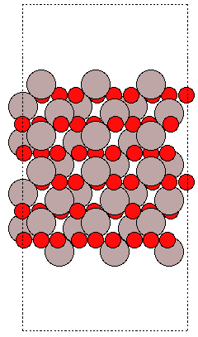
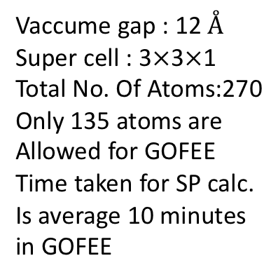
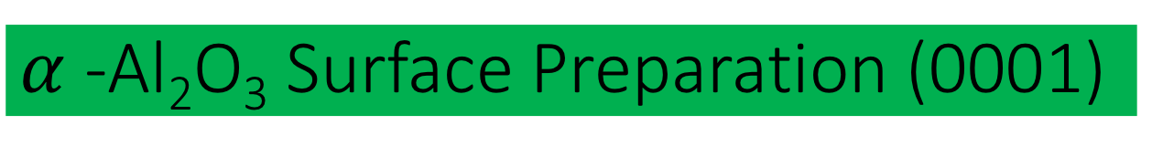
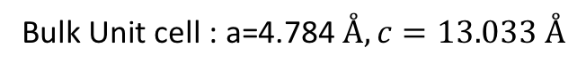
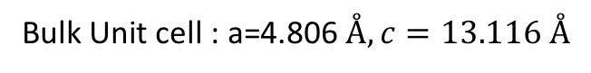
$α$-Al₂O₃ Surface Preparation (0001)
Energy fitness
Strain filter
Bulk Unit cell : a=4.806$Å, c=13.116 Å$
Bulk Unit cell : a=4.784$Å, c=13.033 Å$
Vaccume gap : 12 $Å$
Super cell : 3$×$3$×$1
Total No. Of Atoms:270
Only 135 atoms are
Allowed for GOFEE
Time taken for SP calc.
Is average 10 minutes
in GOFEE
ase.surface()

Slide 5
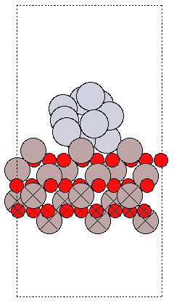
On-the fly Fitting of KRR Model(GOFEE)
Generate Initial Population
SP DFT setup:
Mode: LCAO
Basis set: dzp
Kpts=111
Train the Model
Generate new child structures with mutation operations
Up date the population
Relax with Model
Select best fitness structure
Calculate SP DFT

Slide 6
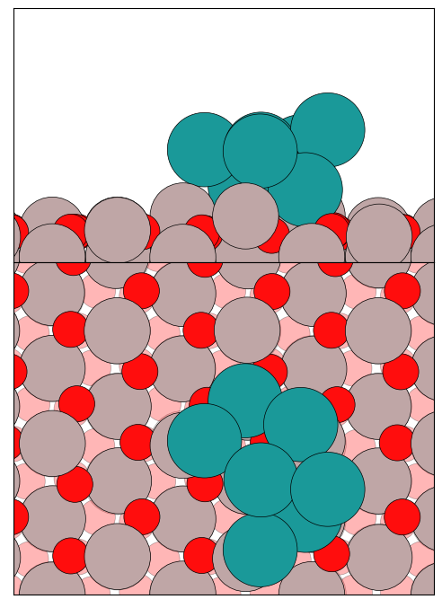
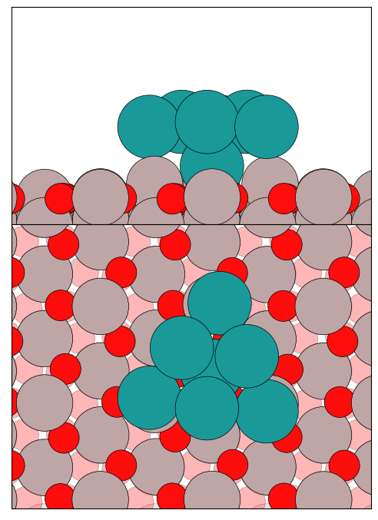
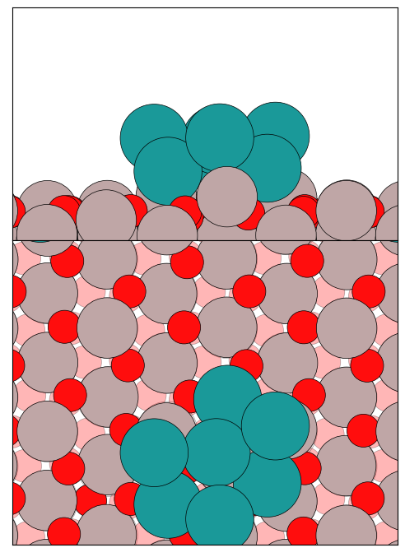
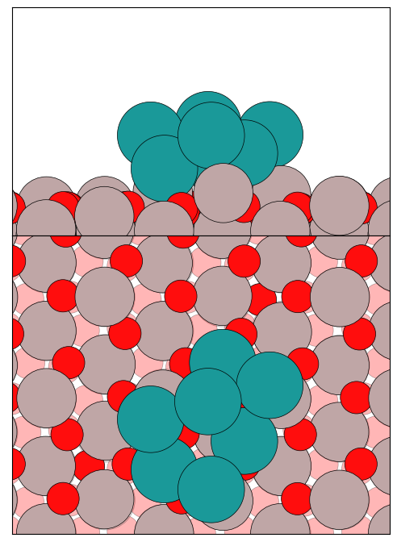
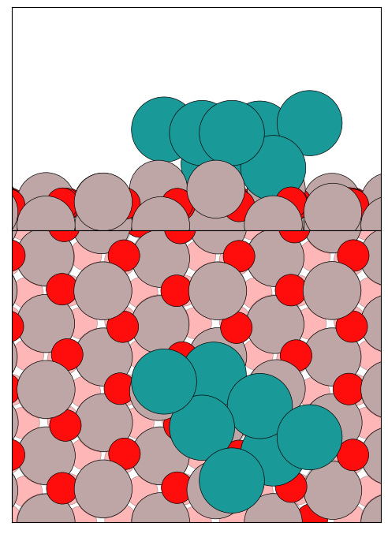
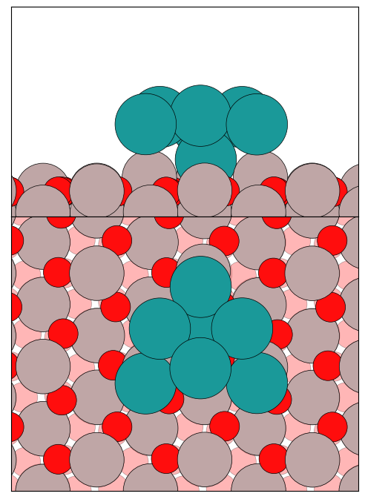
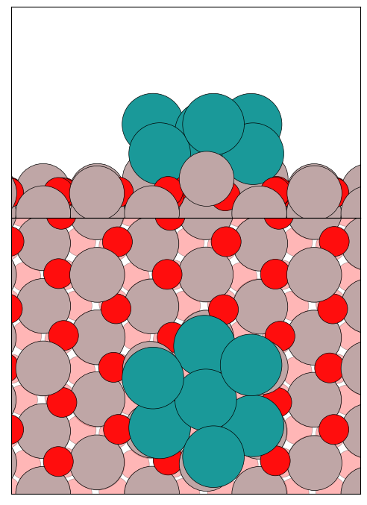
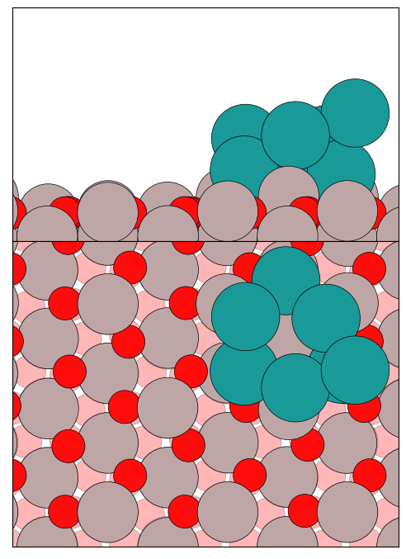
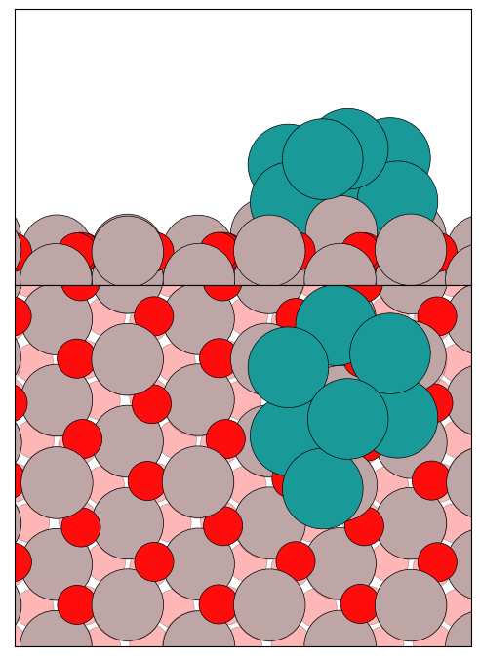
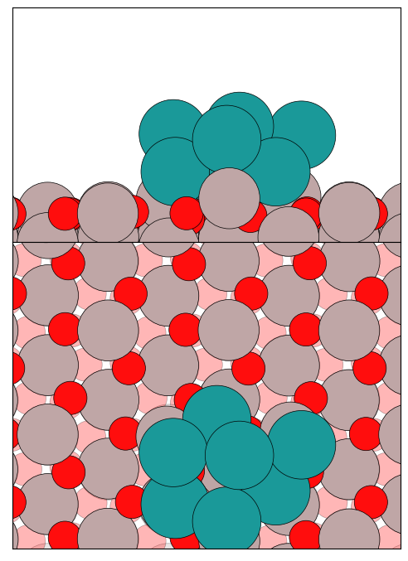
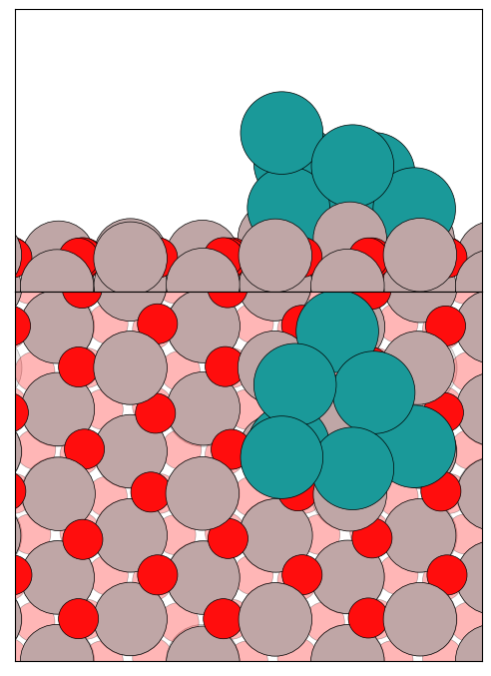
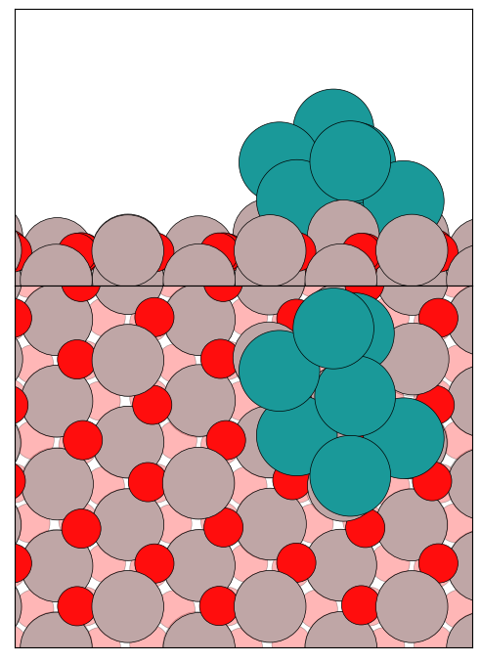
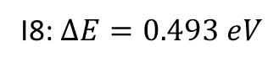
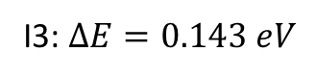
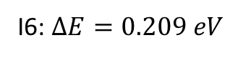
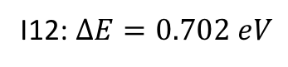
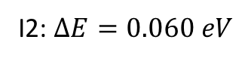
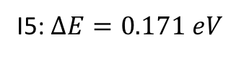
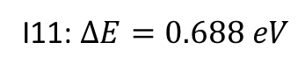
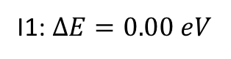
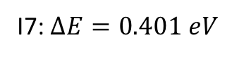
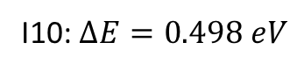
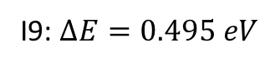
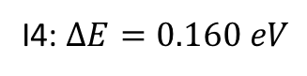
Lowest Energy Structures of Pt₇ clusters
I1: $∆E=0.00 eV$
I2: $∆E=0.060 eV$
I3: $∆E=0.143 eV$
I4: $∆E=0.160 eV$
I5: $∆E=0.171 eV$
I6: $∆E=0.209 eV$
I7: $∆E=0.401 eV$
I8: $∆E=0.493 eV$
I9: $∆E=0.495 eV$
I10: $∆E=0.498 eV$
I11: $∆E=0.688 eV$
I12: $∆E=0.702 eV$
1) Alexandrova et al., J. Phys. Chem. Lett. 2018, 9, 1696−1702.

Slide 7
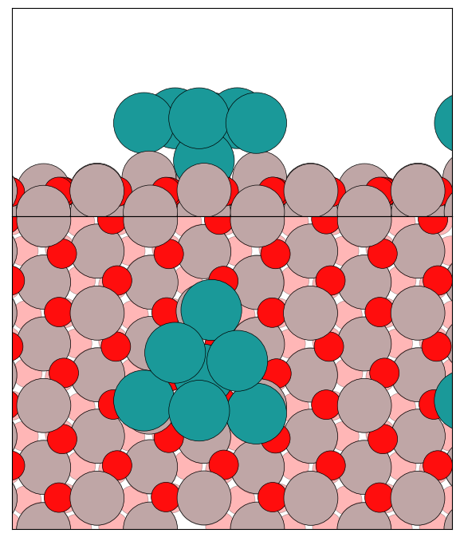


Pt₇ Success rate
Pt₇ O₁₀ Success rate
Pt₇ O₁₂ Success rate

Slide 8












Structural Evolution of Pt₇ with increasing O₂
I1: $∆E=0.00 eV$
Pt₇O₂
Pt₇O₄
Pt₇O₆
I4: $∆E=0.320 eV$
I2: $∆E=0.21 eV$
I3: $∆E=0.30 eV$
I2: $∆E=0.060 eV$
Pt₇O₈
Pt₇O₁₀
Pt₇O₁₂

Slide 9


























Energy Level Diagram for Pt₇O_{x}(x=0) + CO
I1: $∆E=0.000 eV$
I2: $∆E=0.07 eV$
I3: $∆E=0.16 eV$
I4: $∆E=0.17 eV$
I5: $∆E=0.41 eV$
I6: $∆E=0.42 eV$
I7: $∆E=0.51 eV$
I7: $∆E=0.91eV$
I5: $∆E=0.56 eV$
I1: $∆E=0.000 eV$
I6: $∆E=0.86 eV$
I2: $∆E=0.02 eV$
I4: $∆E=0.39 eV$
I3: $∆E=0.24 eV$

Slide 10








































Energy Level Diagram for Pt₇O_{x}(x=0,4) + CO
I1: $∆E=0.000 eV$
I2: $∆E=0.07 eV$
I3: $∆E=0.17 eV$
I4: $∆E=0.42 eV$
I5: $∆E=0.51 eV$
I6: $∆E=0.72 eV$
I7: $∆E=0.81 eV$
I1: $∆E=0.000 eV$
I2: $∆E=0.22 eV$
I3: $∆E=0.44 eV$
I4: $∆E=1.17 eV$
I5: $∆E=1.19 eV$
I6: $∆E=1.35 eV$
I7: $∆E=1.63 eV$
I8: $∆E=2.15 eV$
I1: $∆E=0.000 eV$
I2: $∆E=0.13 eV$
I3: $∆E=0.29 eV$
I4: $∆E=0.46 eV$
I5: $∆E=0.56 eV$
I6: $∆E=0.74 eV$
I7: $∆E=1.72 eV$
I8: $∆E=2.09 eV$

Slide 11

















Energy Level Diagram for Pt₇O_{x}(x=0,10) + CO
I1: $∆E=0.000 eV$
I2: $∆E=0.07 eV$
I3: $∆E=0.17 eV$
I4: $∆E=0.42 eV$
I5: $∆E=0.51 eV$
I6: $∆E=0.72 eV$
I7: $∆E=0.81 eV$
I1: $∆E=0.000 eV$
I2: $∆E=0.24 eV$
I3: $∆E=0.58 eV$
I4: $∆E=2.11 eV$
I5: $∆E=2.28 eV$
I1: $∆E=0.000 eV$
I2: $∆E=1.14 eV$
I3: $∆E=1.29 eV$
I4: $∆E=1.77 eV$

Slide 12
CO
?
CO
CO₂
CO
CO₂
Pt₇
Pt₇O₄
Pt₇O₁₀

Slide 13


UHV chamber
CO₂
1 % (CO + O₂) + He
Partial pressure =8 Torr
ALD-Pt7/Al2O3(0001)
CO + O₂ $→$ Pt –O-O-C-O-Pt $→$CO₂

Slide 14



Stability of Pt₇ Oxides
Pt₇O₂
Pt₇O₄
Pt₇O₆
Pt₇O₈
Pt₇O₁₀
Pt₇O₁₂
Pt₇O₁₄
Pt₇O₁₈
E_{f} = 0.00 eV
-4.23 eV
Pt₇
E_{f} = -4.23 eV
-4.00 eV
Pt₇O₂
E_{f} = -8.23 eV
-3.47 eV
Pt₇O₄
E_{f} = -11.70 eV
-1.97 eV
Pt₇O₆
E_{f} = -13.67 eV
-2.07 eV
Pt₇O₈
E_{f} = -15.74 eV
-1.53 eV
Pt₇O₁₀
E_{f} = -17.27 eV
E_{f} = -17.32 eV
-1.37 eV
Pt₇O₁₂
E_{f} = -18.64 eV
Pt₇O₁₈
1.32 eV
Pt₇O₁₄

Slide 15

Adsorption Energies of CO

Slide 16



























GM structures for Pt-Oxide/Al₂O₃Clusters and Ads./Chem. of CO
Pt₇
Pt₇O₂
Pt₇O₄
Pt₇O₆
Pt₇O₈
Pt₇O₁₀
Pt₇O₁₂
Pt₇O₁₄
Pt₇O₁₆
Adsorption of CO on Pt₇O_{y}
CO + Pt₇O_{y} $→$ Pt₇O_{y}CO

Slide 17












Success Rate of Pt-Oxides with CO Chemisorption
Pt₇
70% (14/20 restarts)
N_itr=500
Pt₇O₂
35% (7/20 restarts)
N_itr=1000
Pt₇O₄
50% (10/20 restarts)
N_itr=1000
Pt₇O₆
41% (7/17 restarts)
N_itr=2000
Pt₇O₈
10% (2/20 restarts)
N_itr=1500
Pt₇O₁₀
50% (10/20 restarts)
N_itr=1500
Pt₇O₁₂
40% (8/20 restarts)
N_itr=1000
Pt₇O₁₄
10% (2/20 restarts)
N_itr=1000
Pt₇O₁₆
30% (3/10 restarts)
N_itr=1000
Pt₇CO (GM)
35% (7/20 restarts)
N_itr=850
Pt₇CO (lM1)
15% (3/20 restarts)
N_itr=850
Pt₇O₂CO(LM1)
30% (3/10 restarts)
N_itr=1100
Pt₇O₄CO(GM)
5% (1/20 restarts)
N_itr=850
Pt₇O₄CO (LM1)
20% (4/20 restarts)
N_itr=850
Pt₇O₄CO (LM2)
20% (4/20 restarts)
N_itr=850
Pt₇O₂CO(GM)
20% (2/10 restarts)
N_itr=1100
Pt₇O₂CO(GM)
20% (2/10 restarts)
N_itr=1100
$∆E=0.000 eV$
$∆E=0.245 eV$
$∆E=0.02 eV$
$∆E=0. 12 eV$
$∆E=0.000 eV$
$∆E=0.132 eV$
$∆E=0.469 eV$

Slide 18
















Pt₇O₆CO(GM)
20% (2/10 restarts)
N_itr=900
Pt₇O₆CO
20% (2/10 restarts)
N_itr=900
Pt₇O₈CO(GM)
13% (2/15 restarts)
N_itr=900
Pt₇O₈CO(lM1)
13% (2/15 restarts)
N_itr=900
$∆E=0.000 eV$
$∆E=0.080 eV$
$∆E=0.451 eV$
$∆E=0.539 eV$
$∆E=0.000 eV$
$∆E=0.090 eV$
Pt₇O₁₀CO(GM)
26% (4/15 restarts)
N_itr=1000
Pt₇O₁₂CO(GM)
20% (2/10 restarts)
N_itr=900
Pt₇O₁₂CO(lm)
20% (2/10 restarts)
N_itr=900
Pt₇O₁₄CO(GM)
20% (3/15 restarts)
N_itr=800
Pt₇O₁₆CO(GM)
10% (1/10 restarts)
N_itr=750
$∆E=0.000 eV$
$∆E=0.000 eV$
$∆E=0.800 eV$
$∆E=0.000 eV$
$∆E=0.000 eV$

Slide 19


Stability of Pt7-Oxides with CO

Slide 20





























Pt₇

Slide 21


Pt₇O₁

Slide 22




















Fig 2
Pt₇O₂
Pt₇O₂CO

Slide 23






Pt₇O₃

Slide 24



















Fig 3
Pt₇O₄
Pt₇O₄CO

Slide 25








Pt₇O₅

Slide 26


















Fig 4
Pt₇O₆
Pt₇O₆CO

Slide 27





Pt₇O₇

Slide 28















Fig 5
Pt₇O₈

Slide 29
Extra Stability of Pt₇O₂CO
Pt₇O₂ + CO
Pt₇+O
Pt₇O + O
Pt₇O₂ + CO
Pt₇ + CO
CO + Pt₇O₂
Pt₇O₂ + CO
- CO₂

Slide 30















Fig 6
Pt₇O₁₀
Pt₇O₁₀CO

Slide 31













Fig 7
Pt₇O₁₂
Pt₇O₁₂CO

Slide 32












Fig 8
Pt₇O₁₄
Pt₇O₁₄CO

Slide 33










Fig 9
Pt₇O₁₆
Pt₇O₁₆CO

Slide 34










Slide 35






























Pt₇CO
Pt₇O₂CO
Pt₇O₄CO
Pt₇O₆ CO
Pt₇O₈CO
Pt₇O₁₀CO
Pt₇O₁₂CO
Pt₇O₁₄CO
Pt₇O₁₆CO

Slide 37












































Lowest Energy Structures of Pt₇ + x O₂ Clusters
Pt₇O₂
I1: $∆E=0.000 eV$
I2: $∆E=0.032 eV$
I3: $∆E=0.131 eV$
I4: $∆E=0.166 eV$
I5: $∆E=0.311 eV$
I6: $∆E=0.444 eV$
I7: $∆E=0.451 eV$
I8: $∆E=0.456 eV$
Pt₇O₄
I1: $∆E=0.000 eV$
I2: $∆E=0.223 eV$
I3: $∆E=0.417 eV$
I4: $∆E=0.442 eV$
I5: $∆E=0.489eV$
I6: $∆E=0.512 eV$
I7: $∆E=0.515eV$
I8: $∆E=0.679eV$
Pt₇O₆
I1: $∆E=0.000 eV$
I2: $∆E=0.201 eV$
I3: $∆E=0.304 eV$
I4: $∆E=0.315 eV$
I5: $∆E=0.409 eV$
I6: $∆E=0.564 eV$
I7: $∆E=0.591 eV$
I8: $∆E=0.599 eV$

Slide 38









Lowest Energy Structures of Pt₇ + x O₂ Clusters
Pt₇O₈
Pt₇O₁₀

Slide 39

























Lowest Energy Structures of Pt₇ + x O₂ Clusters
Pt₇O₁₂
I1: $∆E=0.000 eV$
I2: $∆E=0.134 eV$
I3: $∆E=0.242 eV$
I4: $∆E=0.319 eV$
I5: $∆E=0.684 eV$
I6: $∆E=0.832 eV$
I7: $∆E=1.201 eV$
I8: $∆E=6.477 eV$
Pt₇O₁₄
Pt₇O₁₈
I3: $∆E=1.010 eV$
I1: $∆E=0.000 eV$
I2: $∆E=0.174 eV$
I3: $∆E=0.526 eV$
I1: $∆E=0.000 eV$
I2: $∆E=0.355 eV$

Slide 40
























Lowest Energy Structures of Pt₁₀ clusters
I1: $∆E=0.00 eV$
I2: $∆E=0.454 eV$
I3: $∆E=0.468 eV$
I4: $∆E=0.616 eV$
I5: $∆E=0.670 eV$
I6: $∆E=0.810 eV$
I7: $∆E=0.871 eV$
I8: $∆E=0.895 eV$
I9: $∆E=0.920 eV$
I10: $∆E=1.082 eV$
I11: $∆E=1.109 eV$
I12: $∆E=1.155 eV$

Slide 41


Pt₁₀ Success rate
Pt₁₀ O₁₂ Success rate
Pt₁₀ O₁₈ Success rate

Slide 42










Structural Evolution of Pt₁₀ with increasing O₂
I5: $∆E=1.66 eV$
I9: $∆E=0.871 eV$
Pt₁₀O₂
Pt₁₀O₄
Pt₁₀O₆
I4: $∆E=1.05 eV$
I1: $∆E=0.00 eV$
Pt₁₀O₁₂
Pt₁₀O₁₈
Pt₁₀O₂₀

Slide 43

Stability of Pt₁₀ Oxides with increasing O₂
Pt₁₀O₂
Pt₁₀O₄
Pt₁₀O₂₀
Pt₁₀O₆
Pt₁₀O₁₂
Pt₁₀O₁₈

Slide 44



































Lowest Energy Structures of Pt₁₀ + x O₂ Clusters
Pt₁₀O₂
Pt₁₀O₄
I1: $∆E=0.000 eV$
I2: $∆E=0.201 eV$
I3: $∆E=0.284 eV$
I4: $∆E=0.416 eV$
I1: $∆E=0.000 eV$
I2: $∆E=0.107 eV$
I3: $∆E=0.498 eV$
I4: $∆E=0.652 eV$
Pt₁₀O₆
Pt₁₀O₁₂
I1: $∆E=0.000 eV$
I2: $∆E=0.210 eV$
I3: $∆E=0.373 eV$
I4: $∆E=0.481 eV$
I1: $∆E=0.000 eV$
I2: $∆E=0.552 eV$
I3: $∆E=0.851 eV$
I4: $∆E=1.131 eV$
Pt₁₀O₂₀
I1: $∆E=0.000 eV$
I2: $∆E=0.448 eV$
I3: $∆E=0.543 eV$
I4: $∆E=0.708 eV$

Slide 45
























Lowest Energy Structures of Pt₁₃ clusters
I1: $∆E=0.00 eV$
I2: $∆E=0.019 eV$
I3: $∆E=0.100 eV$
I4: $∆E=0.251 eV$
I5: $∆E=0.263 eV$
I6: $∆E=0.264 eV$
I7: $∆E=0.264 eV$
I8: $∆E=0.349 eV$
I9: $∆E=0.386 eV$
I10: $∆E=0.409 eV$
I11: $∆E=0.423 eV$
I12: $∆E=0.446 eV$

Slide 46

Pt₁₃ Success rate
Pt₁₃ O₁₈ Success rate

Slide 47









Structural Evolution of Pt₁₃ with increasing O₂
I1: $∆E=0.01 eV$
Pt₁₃O₂
Pt₁₃O₄
Pt₁₃O₆
I3: $∆E=0.24 eV$
Pt₁₃O₁₂
Pt₁₃O₁₈
I2: $∆E=0.09 eV$
I2: $∆E=0.080 eV$

Slide 48

Stability of Pt₁₃ Oxides with increasing O₂
Pt₁₃O₂
Pt₁₃O₄
Pt₁₃O₁₈
Pt₁₃O₆
Pt₁₃O₁₂

Slide 49

























Lowest Energy Structures of Pt₁₃ + x O₂ Clusters
Pt₁₃O₂
Pt₁₃O₄
I1: $∆E=0.000 eV$
I2: $∆E=0.244 eV$
I3: $∆E=0.541 eV$
I4: $∆E=0.651 eV$
I1: $∆E=0.000 eV$
I2: $∆E=0.468 eV$
I3: $∆E=0.577 eV$
I4: $∆E=0.602 eV$
Pt₁₃O₆
Pt₁₃O₁₂
I1: $∆E=0.000 eV$
I2: $∆E=0.238 eV$
I3: $∆E=0.7007 eV$
I4: $∆E=0.886 eV$
I1: $∆E=0.000 eV$
I2: $∆E=0.238 eV$
I3: $∆E=0.775 eV$
Pt₁₃O₁₈
I1: $∆E=0.000 eV$

Slide 50
























Lowest Energy Structures of Pt₈ clusters
I1: $∆E=0.00 eV$
I2: $∆E=0.186 eV$
I3: $∆E=0.188 eV$
I4: $∆E=0.193 eV$
I5: $∆E=0.251 eV$
I6: $∆E=0.288 eV$
I7: $∆E=0.347 eV$
I8: $∆E=0.423 eV$
I9: $∆E=0.457 eV$
I10: $∆E=0.471 eV$
I11: $∆E=0.504 eV$
I12: $∆E=0.518 eV$
2) Alexandrova et al., ACS Catal. 2017, 7, 3322−3335.

Slide 51
Pt₇ Success rate
Pt₈ Success rate

Slide 52








Structural Evolution from Pt₇ to Pt₁₃
I1: $∆E=0.000 eV$
I2: $∆E=0.060 eV$
I1: $∆E=0.000 eV$
I2: $∆E=0.186 eV$
I1: $∆E=0.000 eV$
I2: $∆E=0.019 eV$
I2: $∆E=0.100 eV$
I1: $∆E=0.000 eV$

Slide 53




Oxidation of Pt₇, Pt₁₀ and Pt₁₃ Clusters
$$Pt7+7O2 →Pt7O14$$
$$Pt10+10 O2 →Pt10O20$$
$$Pt13+9 O2 →Pt13O18$$

Slide 54
Future Work
Pt₁₃O₂₆ compositions need to do GO.
We need to see how the catalytic property changes by transformation from cluster to single layer Pt-oxide structures and also size effect.
It will be interesting to know the catalytic properties with respect to ensemble average of different low-lying isomers.

